Slide 1
Use Case Modeling (cont.)
COMP 3700: Modeling and Design
Tuesday, January 24, 2017
Gomaa, 2011; Pettit, 2014

Slide 2
COMET Use Case-Based Software Life Cycle
COMET use case-based software life cycle can be used with
Spiral life cycle model
Unified Software Development Process (USDP/RUP) life cycle model
Use case driven
Highly iterative
We’ll use this one

Slide 3
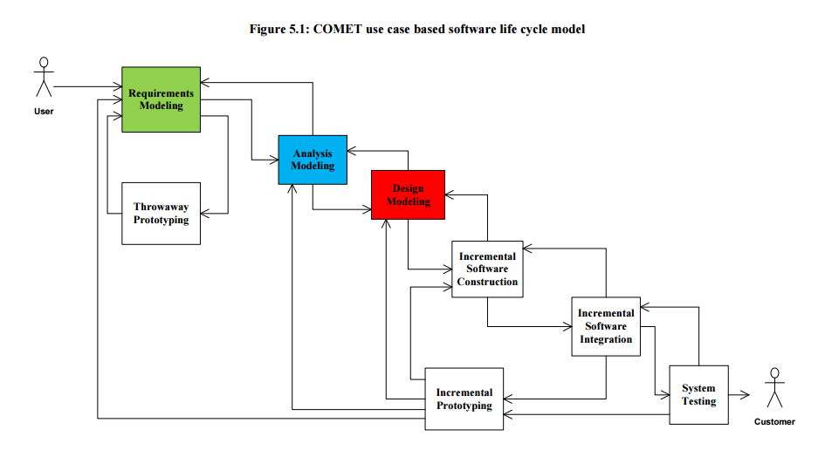
COMET Use Case Based Software Life Cycle Model

Slide 4
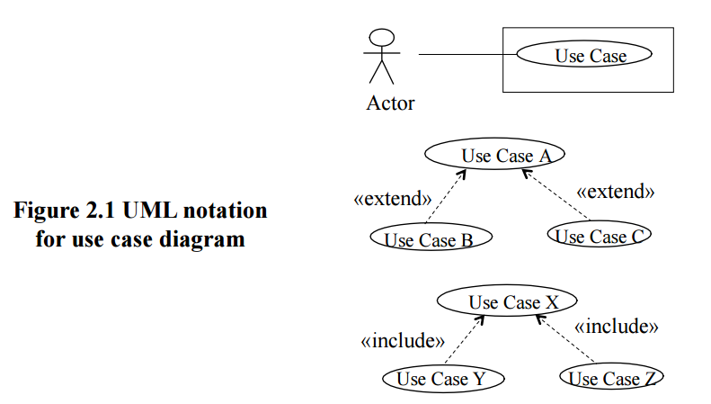
Requirements Modeling
Use Case Modeling
Define software functional requirements in terms of use cases and actors
Narrative description of each use case is developed
User inputs and active participation are essential to this effort

Slide 5
Use Cases are one way to capture requirements
A visual way to capture functional requirements
Each bubble is a discrete
user goal
Actors can be people, or
external systems
Each bubble is mapped to a
textual description

Slide 6
Use Case Description
Includes basic and alternate/exception flows
Each alternate flow must start at a step in the basic flow, and may return to a step in the basic flow
Exception flows are analogous to exceptions in code
Includes preconditions
Do not use language that hints at implementation details or system interactions
Avoid click, press, type, button, etc.
Unnecessarily limits creativity

Slide 7
Use Case Diagrams
Made up of three components
Actors (people or external systems)
Use Cases (with textual descriptions)
Relationships
Record class grades
Review Transcripts
Teacher
Authorized
Staff Worker
Student

Slide 8
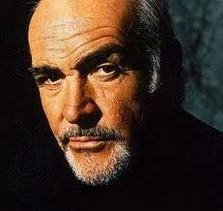
How to construct Use Cases: First, identify actors
Who or what will provide input to the system?
Who or what will need output from the system?

Slide 9
Relationships between actors
One can be a specialization of another
Graduate student is a specialization of Student
Actors are classes, not individual people
Musicians NOT Jay-Z or Beyonce
Student
Graduate Student

Slide 10
How to construct use cases: Next, identify user goals
User Goals are statements that represent what the users need to accomplish, independent of specific software features
“Buy a book”
“Return a book”
“View order history”
“Record a log for a
transaction”
http://destineemccaskill.com/goals/

Slide 11
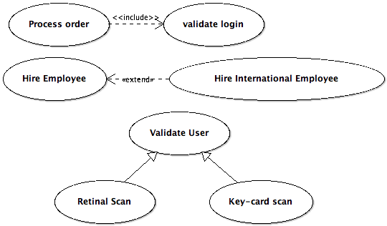
How to construct use cases: Finally, add relationships
Three types of relationships for use cases:
Includes
Extends
Generalization

Slide 12
Includes relationship
One use case can invoke the behavior of another
arrow goes toward included use case
Not always, but often a precursor
I.e. the “Buy a book” use case includes the “Authenticate customer”
Always reflect functionality that is common to more than one use case
See Section 6.8.1 in Gomaa for example of includes relationship
Alter Student Grade
<<includes>>
Record Grades for a Section
Teacher

Slide 13
Extends Relationship
Similar to the includes, but used for handling an abnormal situation (exception checking)
arrow goes toward extended use case
Asks questions
Akin to if->then construct
See 6.9 in Gomaa for an example of the extends relationship
Alter Student Grade
<<extends>>
Alter student grade for a class taken more than a year ago
Authorized
Staff Worker

Slide 14
Generalization Relationship
Replaces generic functionality with an concrete implementation
arrow goes toward extended use case
Authenticate user
Authenticate by card swipe
User
Authenticate by iris scan

Slide 15
Why Use Cases?
Visual representation easy to understand
Relationships are opportunities for reuse
Use case descriptions can be basis for testing
Can be the basis for planning and scheduling

Slide 16
Quick Check-In
Stick Figure?
Oval?
Lines (arcs):
<< >>?
box?
Alter Student Grade
<<includes>>
Record Grades for a Section
Teacher

Slide 17
Participation Activity 1: In-Class Use Case Modeling Exercise
1. Draw a use case diagram for the following system:
The website shall allow users to view all of their bills with Shelby County (such as trash bills, water bills property taxes due, and parking tickets). A bill is expected to be paid on time, but there should be a mechanism to pay a late bill as well. To pay a bill, the user can choose the method (card, online check, or bank draft), the payment date, and the amount of the bill to pay. The user can view their current and past bills. Each evening, the system will interact with an external database that is able to process the daily payment transactions. This database interacts with the credit card companies and banks directly to process the payments.
Before viewing or paying any bills, the user must authenticate with the system by providing their username and password. If they don’t have these credentials, there will be an option on the homepage to create an account. Otherwise, once the user successfully logs in, they are able to view all of their bills and select to pay one or more bills.
2. If generalization relation(s) exist in your use case diagram (hint: at least one should), write a use case description for at least one of those generalization relations
Upload your use case diagram and use case description into Canvas

Slide 18
Use Case Diagram
See template in Canvas for structure and prompts for content

Slide 19
Preparation Activity 2
Write up responses to the following questions (Due by 11:59pm tonight (1/24/17)):
What is a single use case?
What is a use case description?
What is a use case diagram?
What is an actor?
What is a relation?
includes relation?
extends relation?
generalization relation?
which way does the arrow go?
Upload Participation Activity 1 deliverables (Due by Tuesday, January 31, 2017)

Slide 20
Use Case Guidelines
Use case relationships should be employed judiciously
Small inclusion cases corresponding to individual functions should not be considered as they are too small and will fragment the use case
Result in use case descriptions that are only a sentence and not a description of a sequence of interactions
Nonfunctional requirements can be specified in a separate section of the use case description
For large systems, having to deal with a number of use cases in the use case model often gets unwieldy
Scale up issues can be handled by use case packages
Group together related use cases and represent high-level requirements that address major subsets of the functionality of the system
Use cases can also be grouped into packages based on the major actors that use them
Nonfunctional requirements that apply to a group of related use cases could be assigned to the use case package that contains those use cases

Slide 21
Activity Diagrams
A UML diagram depicting the flow of control and sequencing among activities
Shows:
Sequence of activities
Decision nodes
Loops
Concurrent activities
A use case model can also be described using an activity diagram
Can be used to represent the sequential steps of a use case including the main sequence and all the alternative sequences
Provides a more precise description of the use case
Shows exactly where in the sequence and what the condition is for an alternative sequence to diverge from the main sequence

Slide 22
Activity Diagrams
Activity nodes
Can be aggregate nodes that are hierarchically decomposed to give a lower-level activity diagram
Can be used to depict inclusion and extension use cases
Activity node in a base use case can be used to represent a link to an inclusion or extension use case, which is depicted on a separate lower-level activity diagram
Example: Make Order Request

Slide 23
Activity Diagrams: Make Order Request

Slide 24
Participation Activity 2: Activity Diagrams
Working in the same groups that you were in for Preparation Activity 2b, represent the use case diagram your group created for Preparation Activity 2b as an activity diagram. Be sure to use activity nodes, decision nodes, arcs to join sequential activity nodes, and loops in your activity diagram.
As you create your activity diagram, you may notice errors or additions that need to be made in your use case diagram and description. Please correct those errors and make those additions.
Upload the following deliverables in Canvas:
Activity diagram
Updated Use case diagram
Updated use case descriptions
Print out your updated use case diagram, updated use case descriptions, and activity diagram and bring them with you to class on Tuesday, February 2nd

